Slide 1

Market Expansion Analysis for Cenia Enterprise
US-Based Office Supplies & Accessories Wholesale Company
Goal: Expand into North America & Western Europe by Q4 2027
Prepared by: Onyeukwu Emeka

Slide 2


Agenda
01
02
03
Introduction
Project Methodology
Analytics Insights
04
05
SMART Recommendations
Conclusion

Slide 3

Introduction
Cenia Enterprise is a wholesale company specializing in office supplies, furniture, and accessories. This project analyzes sales performance from 2014 to 2017, highlighting revenue trends, profit growth, regional performance, product categories, and customer segments.
The goal is to use these insights to guide the company's planned expansion into new international markets across North America and Western Europe by Q4 2027.

Slide 4
Project Methodology
1
2
Data Preparation
Data Cleaning & Evaluation
Created a backup copy of the dataset to maintain data integrity.
Checked for and removed duplicate rows.
Treated missing values where necessary.
Standardized date, category, and numerical formats.
3
4
Feature Engineering
Exploratory Data Analysis (EDA)
Created Profit Margin to measure how much revenue converts to profit.
Analyzed sales, profit, orders, customer segments, categories, and regions.
Extracted Year from Order Date for time trend analysis.
Used interactive visuals to uncover trends and KPIs.
Developed dashboards for Revenue, Profit, Orders, and Category Insights.

Slide 5
Analytics Insights (1/3: Revenue, Profit & Orders Trends)
Year-over-Year (YoY) Performance (2014–2017)
$2.3M
$286K
9,994
Total Revenue
Total Profit
Total Orders
1. Orders Growth
2. Revenue Growth
3. Profit Growth
Orders increased steadily from ~1,700 in 2014 to over 3,000 in 2017.
Revenue rose consistently from $484,247 (2014) to $733,215 (2017).
Profit increased from $49,544 in 2014 to $93,439 in 2017.
Shows strong and stable demand expansion.
Indicates improved cost management and better product mix.

Slide 6
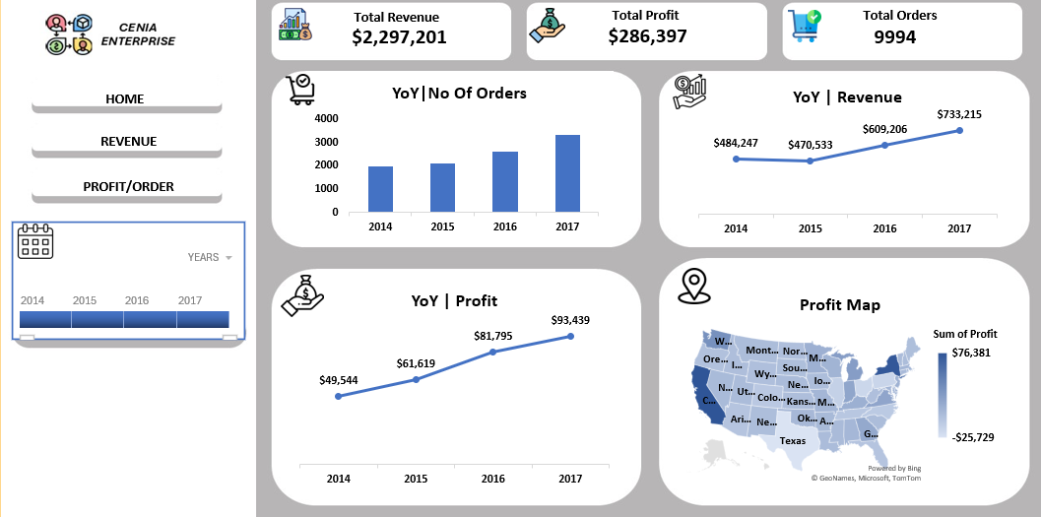

Slide 7
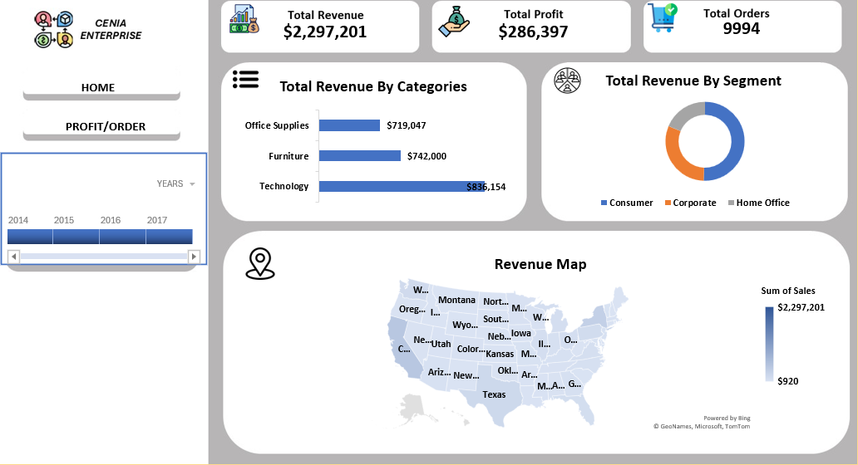

Slide 8
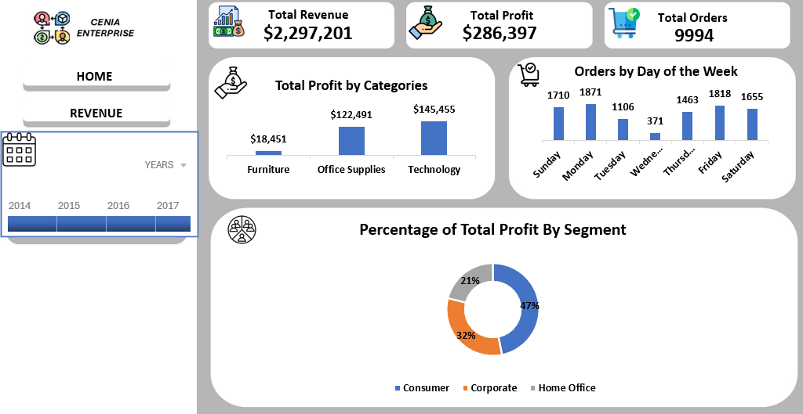

Slide 9
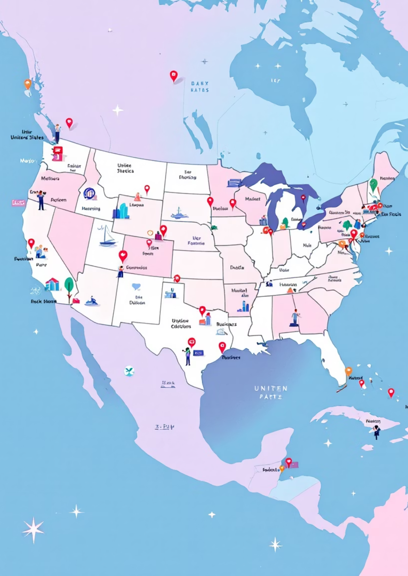

Analytics Insights (2/3: Regional Insights)
Profit Map Findings
Highest Profit States:
California
New York
Washington
Texas
These states fall into high-population, high-business-density markets.
Revenue Map Findings
Revenue distribution also follows major business hubs and metro regions.
Interpretation: Regions with a higher concentration of businesses, corporate offices, and home-office workers drive more revenue and profit. This validates a metropolitan-focused expansion strategy.

Slide 10
Analytics Insights (3/3: Categories, Segments & Order Behavior)
1. Revenue by Category
3. Revenue by Segment
Technology: $836,154 (Highest revenue generator)
Consumer: (~47%)
Furniture: $742,000
Corporate: (~32%)
Office Supplies: $719,047
Home Office: (~21%)
2. Profit by Category
Insight: Consumer & corporate markets are strongest. Home-office demand is smaller but steady.
Technology: $145,455 (Most profitable category)
Office Supplies: $122,491
4. Orders by Day of the Week
Furniture: $18,451 (Very low profit margin)
Highest order days: Monday, Friday, Sunday
Lowest: Wednesday & Thursday
Interpretation: Consumer-driven behavior influences demand, with more orders clustered around weekends and the start/end of workweeks.

Slide 11


SMART Recommendations
Aligned with Insights
S — Specific
M — Measurable
A — Achievable
Target high-density business and tech-heavy metro areas
Achieve 20% revenue growth from Technology & Office Supplies categories by Q2 2027 in new markets since they currently contribute the highest revenue/profit.
Establish two regional distribution hubs
One in Toronto or Montreal
For North America: Toronto, Vancouver, Chicago
One in Amsterdam or Frankfurt
For Western Europe: London, Berlin, Amsterdam
Expected impact: Reduce shipping time by 30% and logistics costs by 15%.
These closely mirror high-performing US states like California and New York.
R — Relevant
T — Time-Bound
Replicate successful US customer segmentation
Launch phased expansion by:
Focus marketing on Consumer (47%) and Corporate (32%) segments.
Canada – Q4 2026
UK – Q2 2027
Use office-tech bundles since Technology is the top revenue and profit driver.
Germany – Q4 2027
Reach profitability in new regions by Q4 2028, measured by achieving a profit margin ≥ 12%, matching current US performance.

Slide 12

Conclusion
Cenia Enterprise shows strong sales growth, increasing profitability, and stable consumer and corporate demand from 2014–2017. High-performing states indicate that expansion into similar metropolitan and high-income regions abroad is both feasible and strategic.
By implementing the SMART recommendations, Cenia Enterprise is positioned to launch a successful expansion into North America and Western Europe by Q4 2027.

